Slide 1




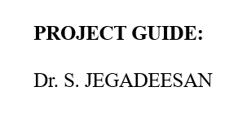
PRE CRASH BRAKING SYSTEM

Slide 2
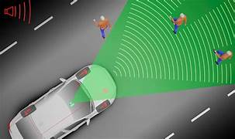
INTRODUCTION
The AEB system performance is aﬀected by both the intrinsic and extrinsic factors of the equipped vehicle while driving. Intrinsic factors cover on-board sensing, decision-making as well as actuation, while extrinsic factors deal with other than the vehicle itself. study further divides these factors into three categories according to the level of inﬂuence: vehicle, driver, and environment factors

Slide 3

LITERATURE SURVEY
The “autonomous” of the AEB system primarily means that the driver’s intervention is not re-quired. However, each driver’s driving style varies owing to his or her characteristics, such as driver’s age, gender, experience, responsiveness, and psychological endurance.

Slide 4
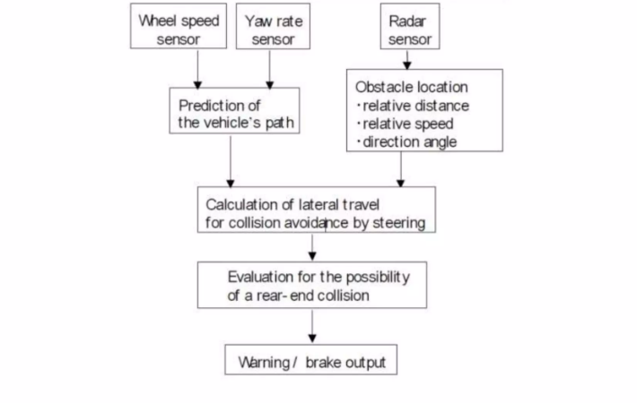
FLOW CHART

Slide 5
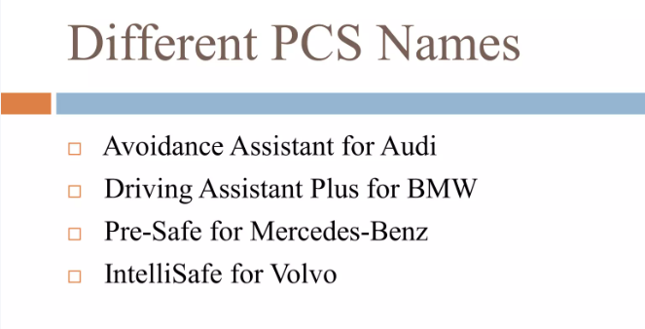

Slide 6

CONCLUSION AND FUTURE SCOPE
The results show that under the same conditions, the braking distance obtained by the Seungwuk Moon algorithm was the most reasonable and the eﬀect was optimum. Berkeley algorithm, braking distance distribution was reasonable and simple when considering fewer factors. The Mazda algorithm was too conservative because its calculated breaking distance is clearly large, which leads to a high alarm rate and reduces user’s trust. The Honda algorithm was relatively too radical because its calculated braking distance is clearly small, and the system intervention time was delayed.

Slide 7


